Slide 1
What is Big Data ?
DataVault LLC

Slide 2

Big Data is also data but with a huge size. Big Data is a term used to describe a collection of data that is huge in volume and yet growing exponentially with time.
In short, such data is so large and complex that none of the traditional data management tools are able to store it or process it efficiently.

Slide 3
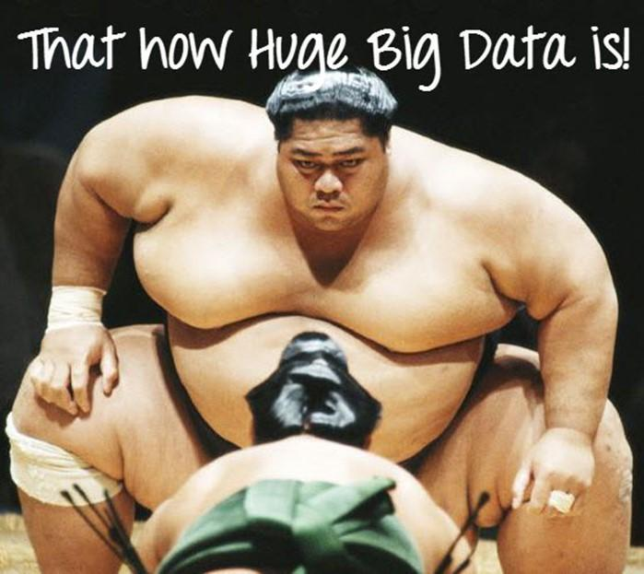

Slide 4
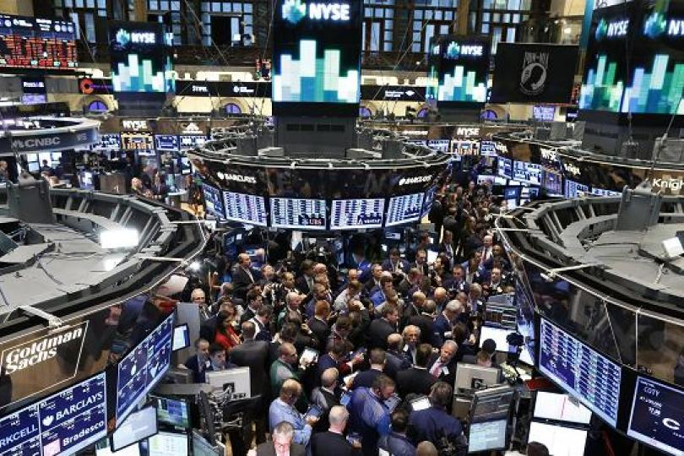
Some Examples...
The New York Stock Exchange generates about one terabyte of new trade data per day.

Slide 5

Some more Examples...
Social Media
The statistic shows that 500+terabytes of new data get ingested into the databases of social media site Facebook, every day. This data is mainly generated in terms of photo and video uploads, message exchanges, putting comments, etc.

Slide 6

Some more Examples...
Aviation
A single Jet engine can generate 10+terabytes of data in 30 minutes of flight time.
With many thousand flights per day, generation of data reaches up to many Petabytes.

Slide 7

Type of
BIG DATA
Big Data could be found in three forms:
1- Structured Data.
2- Semi-Structured Data.
3- Unstructured Data.

Slide 8
Structured Data:
Any data that can be stored, accessed and processed in the form of fixed format is termed as a 'structured' data.
Over the period of time, talent in computer science has achieved greater success in developing techniques for working with such kind of data (where the format is well known in advance) and also deriving value out of it.
However, nowadays, we are foreseeing issues when a size of such data grows to a huge extent, typical sizes are being in the rage of multiple zettabytes.
One billion terabytes forms a zettabyte, 1 terabyte = 1000 Gigabytes.

Slide 9
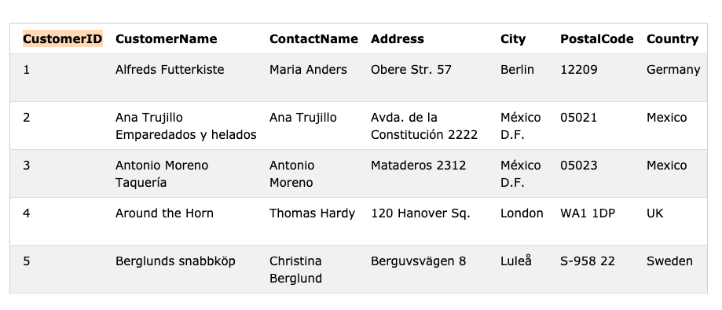
Structured data example:

Slide 10
Semi-structured Data:
Semi-structured data can contain both the forms of data.
We can see semi-structured data as a structured in form but it is actually not defined with e.g. a table definition in relational DBMS.
Example of semi-structured data is a data represented in an XML or JSON file.

Slide 11
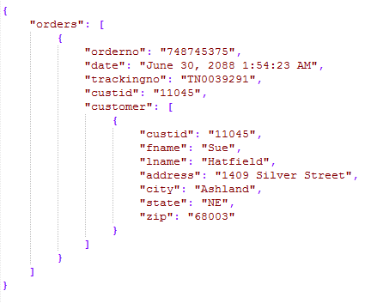
Semi-Structured Data Example:

Slide 12
Unstructured Data:
Any data with unknown form or the structure is classified as unstructured data.
In addition to the size being huge, unstructured data poses multiple challenges in terms of its processing for deriving value out of it.
A typical example of unstructured data is a heterogeneous data source containing a combination of simple text files, images, videos etc.
Now day organizations have wealth of data available with them but unfortunately, they don't know how to derive value out of it since this data is in its raw form or unstructured format.

Slide 13

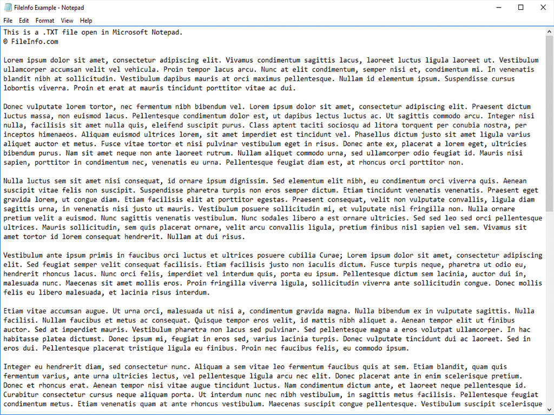

Unstructured Data Example:

Slide 14
Characteristics
of
BIG DATA
Volume
Velocity
Variety
Veracity
Value

Slide 15
Volume:
It refers to the size of Big Data.
Data can be considered Big Data or not is based on the volume.
The rapidly increasing volume data is due to cloud-computing traffic, IoT, mobile traffic etc.

Slide 16
Velocity:
It refers to the speed at which the data is getting accumulated. This is mainly due to IoTs, mobile data, social media etc.
In the year 2000, Google was receiving 32.8 million searches per day. As for 2018, Google was receiving 5.6 billion searches per day!

Slide 17
Variety:
It refers to Structured, Semi-structured and Unstructured data due to different sources of data generated either by humans or by machines.

Slide 18
Veracity:
It refers to the assurance of quality/integrity/credibility/accuracy of the data.
Since the data is collected from multiple sources, we need to check the data for accuracy before using it for business insights.

Slide 19
Value:
Just because we collected lots of Data, it’s of no value unless we garner some insights out of it.
Value refers to how useful the data is in decision making. We need to extract the value of the Big Data using proper analytics.

Slide 20
Benefits of
BIG DATA
Processing
Ability to process
Big Data
brings in multiple benefits,
such as:

Slide 21
Businesses can utilize outside intelligence while taking decisions
Access to social data from search engines and sites like facebook, twitter are enabling organizations to fine tune their business strategies.
Improved customer service
Traditional customer feedback systems are getting replaced by new systems designed with Big Data technologies. In these new systems, Big Data and natural language processing technologies are being used to read and evaluate consumer responses.
Early identification of risk to the product/services, if any
Better operational efficiency
Big Data technologies can be used for creating a staging area or landing zone for new data before identifying what data should be moved to the data warehouse. In addition, such integration of Big Data technologies and data warehouse helps an organization to offload infrequently accessed data.

Slide 22

In conclusion:
Big Data is defined as data that is huge in size. Big Data is a term used to describe a collection of data that is huge in size and yet growing exponentially with time.
Examples of Big Data generation includes stock exchanges, social media sites, jet engines, etc.
Big Data could be 1) Structured, 2) Semi-structured, 3) Unstructured.
5V’s: Volume, Velocity, Variety, Veracity, Value.
Improved customer service, better operational efficiency, Better Decision Making are few advantages of Big Data

